Slide 1
DAT Class 12
Cross Validation, Model Prep

Slide 2
How Do We Know Our Model Will Generalize To The Outside World?

Slide 3
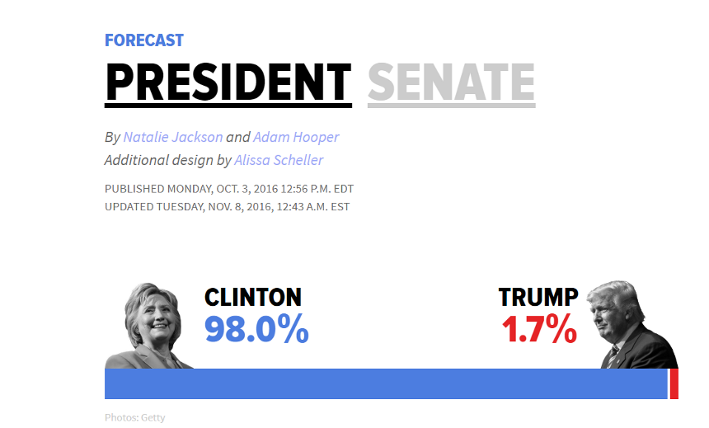

Slide 4
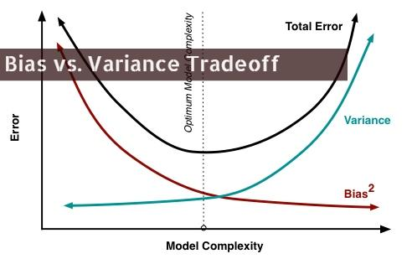

Slide 5
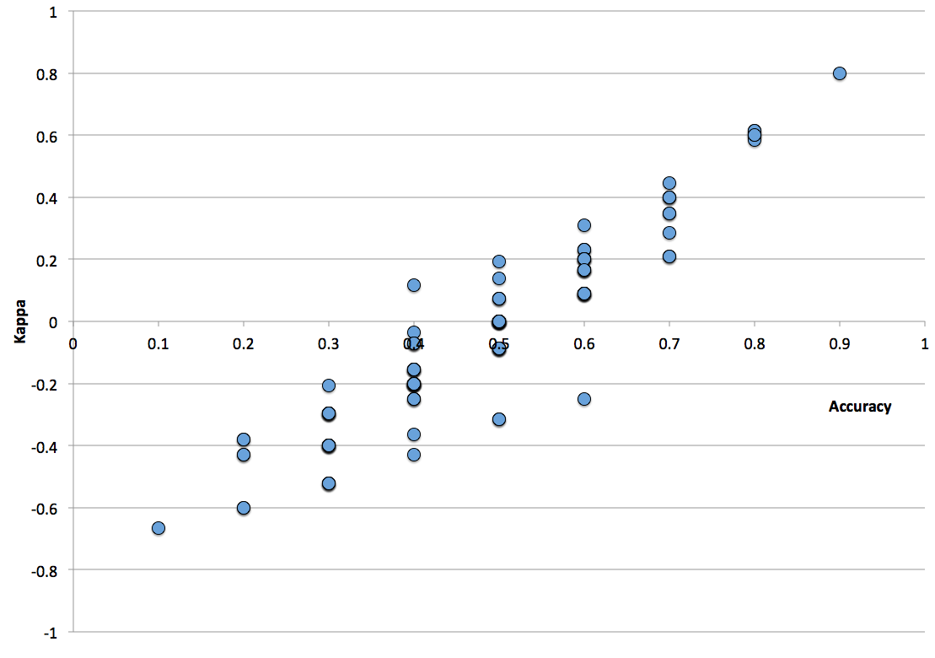
Cross Validation
Bias refers to when your data doesn't adequately capture the information necessary to solve your problem
Variance refers to when your model mistakenly interprets random correlations as meaningful

Slide 6
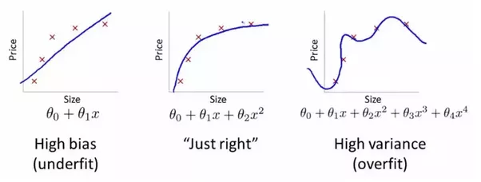

Slide 7
Cross Validation
Basic idea is simple:
Separate your data into two groups, a “test” set and a “training” set
Test set is not touched until the very end, and is only used for final model evaluation
Training set is used for fine-tuning and evaluating your model
Notes:
This is where you go and introduce the training and test split. Go through the shapes of the returned values, make sure everyone is clear on what’s happening.
For

Slide 8
Cross Validation
Additional step is to add a validation set:
Test-set within the test-set
Used to compare results when doing cross validation
Meant to be a portion of your training set that resembles the test set
Notes:
This is where you go and introduce the training and test split. Go through the shapes of the returned values, make sure everyone is clear on what’s happening.
For

Slide 9
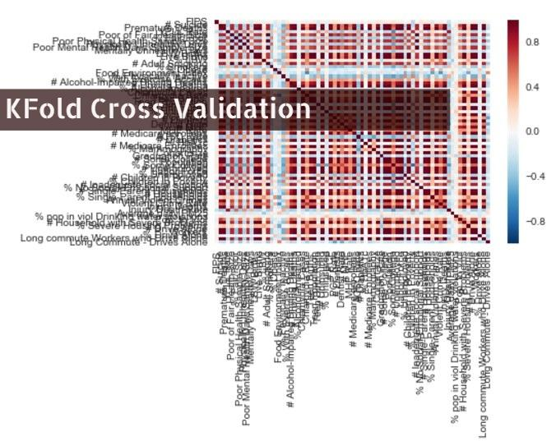
Notes:
This is where you go and introduce the training and test split. Go through the shapes of the returned values, make sure everyone is clear on what’s happening.
For

Slide 10
Cross Validation
Kfold Cross Validation:
More thorough way of cross validation
Split training set into K different groups
For k rounds, train your data on K-1 groups, and score it on the one remaining set
Is only used on the training set
Notes:
This is where you go and introduce the training and test split. Go through the shapes of the returned values, make sure everyone is clear on what’s happening.
For

Slide 11
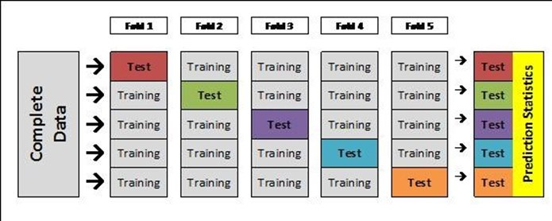
Notes:
After this slide, introduce cross_val_score and how to implement it

Slide 12
Cross Validation
Concept check:
What would be the expected behavior from increasing the number of folds?
When would a larger number of folds make sense?

Slide 13
Cross Validation
Key idea about cross validation:
Allows you to compare changes between models
Ie, your cross validated score gives you a benchmark to use to determine whether or not you’re making progress or not
Notes:
This is where you go and introduce the training and test split. Go through the shapes of the returned values, make sure everyone is clear on what’s happening.
For

Slide 14
Can We Improve Our Model?
Let’s See If We Can Improve Our Model, Using our Cross-Validated Scores as a Guide. Try the following methods:
Non-linear transformations: square, square root, cubic term, etc
Interaction effects: one variable multiplied by another one
Log Transformations: numerically transform a variable to make it more normal
Take 20-25 minutes, and we’ll talk about our results when we’re finished.
Notes:
After this, re-fit on the entire training set, and then score your final model.

Slide 15
Data Prep
Cross Validation, Model Prep

Slide 16
Common Issues In Data Prep:
Handling Missing Data
Encoding categorical columns
There are various ways to deal with these issues, ranging from fairly simple to fairly sophisticated, we’ll try and take a look at a few strategies for both.
Notes:
This is where you go and introduce the training and test split. Go through the shapes of the returned values, make sure everyone is clear on what’s happening.
For

Slide 17
Handling Missing Data
Two big issues:
Is it randomly generated?
Does it encode for something specific?
Determines whether or not empty values should be filled with a single value (ie, ‘None’, 0, etc) or imputed (average, mode, or more elaborate measures).
Notes:
This is where you go and introduce the training and test split. Go through the shapes of the returned values, make sure everyone is clear on what’s happening.
For

Slide 18
Handling Missing Data
Non-random missing values:
Usually means you want to fill in missing values with a small number of discreet values that mean something very specific.
For example, lots of times values like ‘False’, ‘Does not Apply’, ‘Missing’, etc are left empty, or codified as Null values somewhere.
Columns filled in this way will often have lots of similarity with one another with regards to missing values.
Notes:
This is where you go and introduce the training and test split. Go through the shapes of the returned values, make sure everyone is clear on what’s happening.
For

Slide 19
Handling Missing Data
Randomly generated missing values.
Usually means values need to be imputed. Ie, deriving values from properties of that column or the dataset as a whole.
Simple strategy:
Fill in a numeric value with is column mean, categorical column with its mode
Notes:
This is where you go and introduce the training and test split. Go through the shapes of the returned values, make sure everyone is clear on what’s happening.
For

Slide 20
Handling Missing Data
Some more elaborate strategies:
Using results of a groupby() statement to impute missing values
transform() is your friend!
Running a regression on filled values to fill in missing ones
Import Note:
You should try and use values from your training set to make inferences about your test set.
Notes:
This is where you go and introduce the training and test split. Go through the shapes of the returned values, make sure everyone is clear on what’s happening.
For

Slide 21
Categorical Encoding
Cross Validation, Model Prep

Slide 22
Categorical Columns
Lots of important information is encoded in text based columns.
These are typically more difficult to deal with than numeric columns.
Most models require numeric data, so you need some way to create a numeric representation of your data.
Notes:
This is where you go and introduce the training and test split. Go through the shapes of the returned values, make sure everyone is clear on what’s happening.
For

Slide 23
Categorical Columns
Two most common strategies:
Ordinal Encoding: Give columns a numeric rank based on a naturally existing hierarchy.
Small, Medium, Large
Poor, Fair, Average, Good, Very Good,
Sometimes these can be inferred
V-4, V-6, V-8
Fiat, Ford, Audi, Bugatti
OneHot Encoding: Binary representation of whether a column has a particular value
Notes:
This is where you go and introduce the training and test split. Go through the shapes of the returned values, make sure everyone is clear on what’s happening.
For

Slide 24
Categorical Columns
Commonly used methods for both of these:
map() - ordinal encoding
pd.get_dummies() - onehot encoding
Notes:
This is where you go and introduce the training and test split. Go through the shapes of the returned values, make sure everyone is clear on what’s happening.
For

Slide 25
Categorical Columns
What About Columns That Have A Lot of Unique Values?
Common issue
Too many columns can blow up your model!
These are often some of your most important columns!
Zip code, medical billing codes, non-repeating text, etc
General Strategies:
Reduce to a lower dimension
Target Encoding
Notes:
This is where you go and introduce the training and test split. Go through the shapes of the returned values, make sure everyone is clear on what’s happening.
For

Slide 26
Categorical Columns
High Cardinality Columns, Cont:
Common practices:
Create ‘Other’ Value for low frequency values
Group based on average value for target variable
Notes:
This is where you go and introduce the training and test split. Go through the shapes of the returned values, make sure everyone is clear on what’s happening.
For

